Slide 1

Partitioning and Replication
Mahir Mahbub
Lecturer
Dept. of IRE, BDU

Slide 2
Partitioning: Partitioning is the process of dividing a software system's data into more manageable, standalone chunks.
Replication is the process of creating multiple copies of the same data and storing them into multiple machines. Each one of these copies is typically called a replica.

Slide 3

Partitioning
Each one of those units is typically called a partition.
We can then assign one or more partitions to a single machine, where this machine will be responsible for serving requests for the associated data.
These requests can generally belong in two main categories: requests that retrieve some data (read requests) and requests that update some data or create new data (write requests).

Slide 4

Benefit of Partitioning
The system becomes fault-tolerant to failures. Failure of a single machine means only the affected partitions are impacted and users accessing data from the other partitions can continue using the system.
Partitioning a system also makes it easier to scale.
A partitioned system can also provide better and more reliable performance. This is thanks to the fact that each machine needs to handle a smaller workload and can serve it more efficiently. There is also less interference between workloads from different partitions

Slide 5
Types of Partitioning
Horizontal partitioning is when you split a dataset, so that each data record (e.g. a row in a relational database) is kept as a whole in a single partition. This means each partition can hold one or more data records
Vertical partitioning is when you split a dataset, so that each data record is split into pieces and each piece can be assigned to a different partition. This means each partition can hold pieces from multiple records, but each partition might not necessarily contain a data record as a whole.

Slide 6
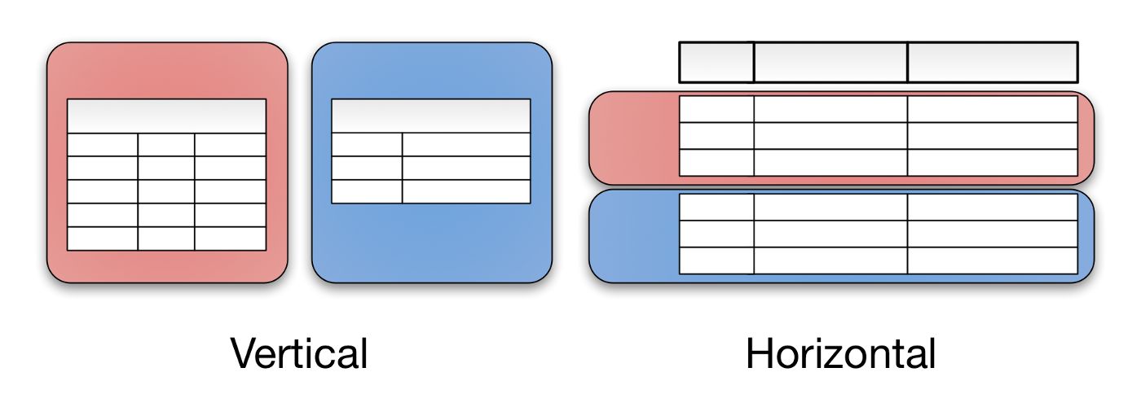
Visual Representation of Partitioning

Slide 7
Some Types of Partitioning
Round-robin: Assigns new rows to partitions in a cyclic, rotation-based manner, distributing data evenly across partitions. This technique is simple to implement and can provide basic load balancing. It's useful for resizing partitions that are not equal in size. However, the table must not have primary keys.
Hash-based: Analyzes data using a hash function to determine which division it belongs to. This technique can help with load balancing and quick data retrieval.
Range: Assigns a given range of values to a partition.
Consistent hashing: Uses a hash function to ensure that resources required by computer programs are efficiently stored in memory, and that in-memory data structures are loaded evenly to make information retrieval more efficient.

Slide 8
Challenges of Partitioning
One challenge around partitioning is the fact that you have to decide how you want to partition the data.
Usually, the way you partition the data depends on how you access it most frequently, so that you can access it in an efficient way.
For example, if you are typically searching data for a single user based on their username, then you can use the username of a user as a partition key.
This will allow your system to quickly locate the partition that contains a user with a specific username and retrieve the corresponding record.

Slide 9
Challenges of Partitioning
However, there are cases where a system needs to access data in different ways.
For example, your system might also need to find a user based on their date of birth or some other attribute. This might mean the system needs to search the whole dataset, thus accessing all the partitions, which will negate some of the benefits derived from partitioning.
For example, single-machine failures can make the whole system unavailable again.

Slide 10
Challenges of Partitioning
One way to avoid this is to create indexes based on those additional attributes, which can be used to find which partition holds a record and then search only this partition. However, this index will also need to be partitioned, which means any write request will generate two updates on the underlying system, one for the actual data and one for each index. If a data record and the corresponding records for its indexes reside on separate machines, we face similar challenges as described above for replication

Slide 11
Benefit of Replication
The main benefit of replication is increased fault tolerance and scalability.
Since the same data is stored redundantly in multiple machines, the whole system can tolerate failure of one or more machines since the users can access the data from a different machine that functions normally.
One can add more backup replicas which can then serve some of those read requests reducing the load on the other replicas.

Slide 12
Replication Protocols
Case Study: Imagine a system that stores the bank balances of users. Now think what would happen if a user tries to deposit some money to his account, one of the replicas handles the request successfully with the user completing the transaction, but then the machine fails. The user then tries to check his balance, but the request is sent to a different replica (as the original has crashed) that hasn’t seen the original deposit request and is thus showing to the user his old balance.

Slide 13
Replication Protocol (Contd.)
For this reason, systems that make use of replication usually make an effort to ensure any updates to the dataset are done in a safe way, so that issues like that don’t happen. This is done through a sophisticated set of rules that define how different replicas communicate when an update needs to be performed and when a request should be considered successful. These are known as replication protocols.

Slide 14
Primary-backup Replication
In primary-backup replication, one of the replicas is designated as the primary and the other replicas are the backups.
All the write requests need to go through the primary replica, which is then responsible for making sure the backup replicas have also performed them before acknowledging to the client that the request has been completed.
As a result, backup replicas can only serve read requests. If the primary replica fails, then one of the backup replicas needs to be designated as the new primary. Until this has happened, no write requests can be served.

Slide 15
Consensus-based Replication
In consensus-based replication, any of the replicas can process write or read requests. However, in order to do this, they have to communicate with the other replicas to make sure any read requests return the right data and write requests will update all the replicas properly.
In other words, they ensure all the replicas are in agreement or consensus, hence the name.
The simplest way to do this is by creating groups of replicas that have to coordinate with each other to process read or write requests. Such a group is typically called a quorum.

Slide 16
Consensus-based Replication
The simplest protocols make use of majority quorums, which are groups that contain more than half the replicas. When using majority quorums, replicas make sure write requests have been performed to more than half of the replicas (> 50%).
In the same way, read requests read data from more than half of the replicas. In this way, replicas can ensure every read request reflects all the completed write requests as the read and the write quorums will always contain one replica that has seen all the write requests so far. Of course, the actual protocol is a lot more complicated than this, so I won’t go into more detail here.
Some examples of consensus-based replication protocols are Raft and Paxos.

Slide 17
Conclusion
Finally, there are many systems that employ both replication and partitioning. In this way, they can reap the benefits of both techniques, but they are also subject to the limitations of both.
The common pattern of doing this is splitting the dataset into separate partitions and then creating multiple replicas for each partition.
The replicas for each partition coordinate with each other as I explained above to complete requests. The system decides whether it also requires communication across partitions depending on what kind of operations and guarantees it needs to provide to its users.

